Slide 1
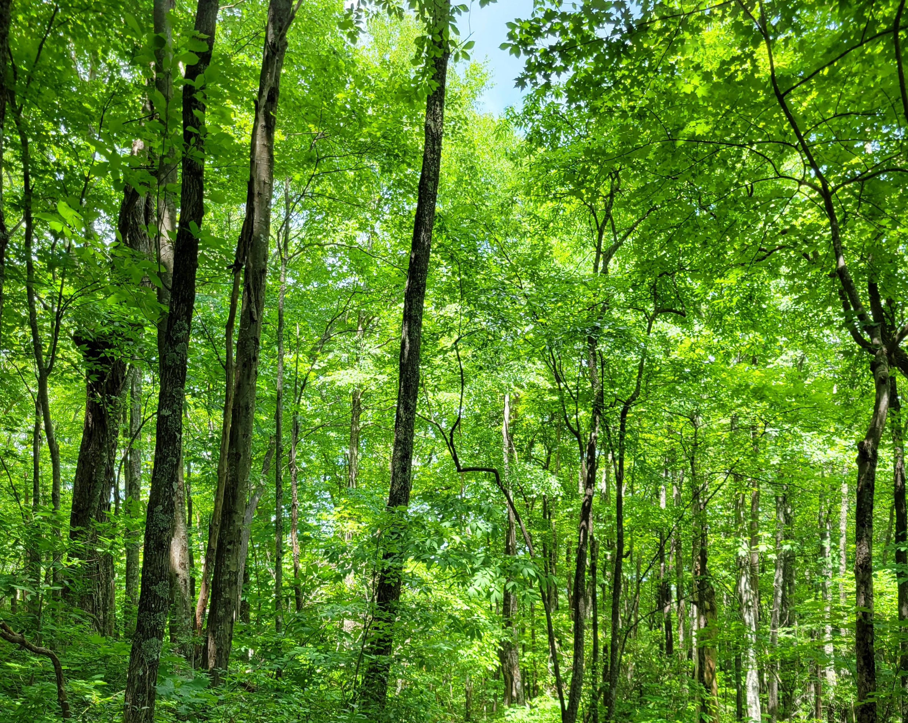
Regulation of nonstructural carbohydrate dynamics
Biological Insights from a Mathematical Analysis
Scott W Oswald, Doug P. Aubrey, Dan M. Ricciuto, Jeff M. Warren
Ecological Society of America, Montréal, QC
August 18, 2022

Slide 2
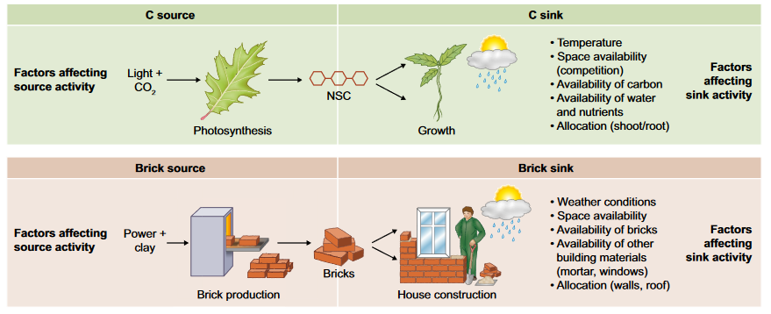
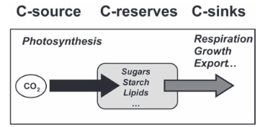
Fig 1. Fatichi et al. 2019
Nonstructural Carbohydrates = NSC
Sala et al. 2011; Sala et al. 2012

Slide 3
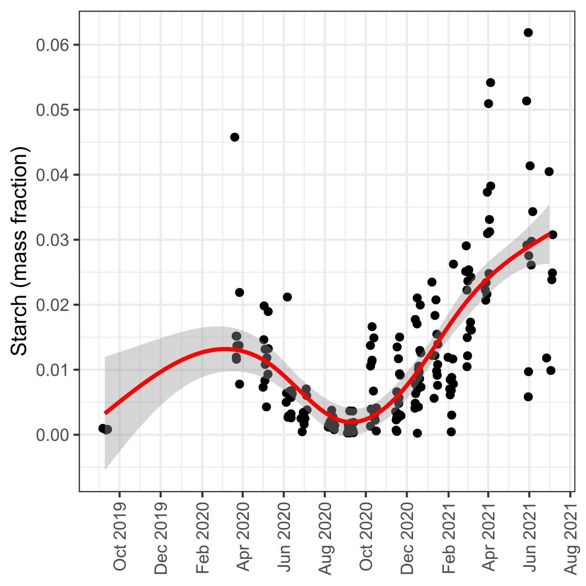
From here to there…

Slide 4
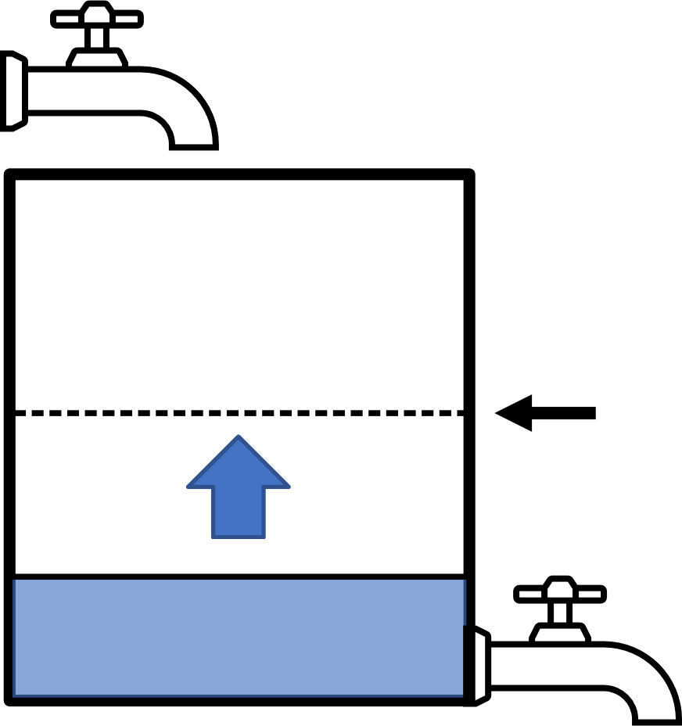
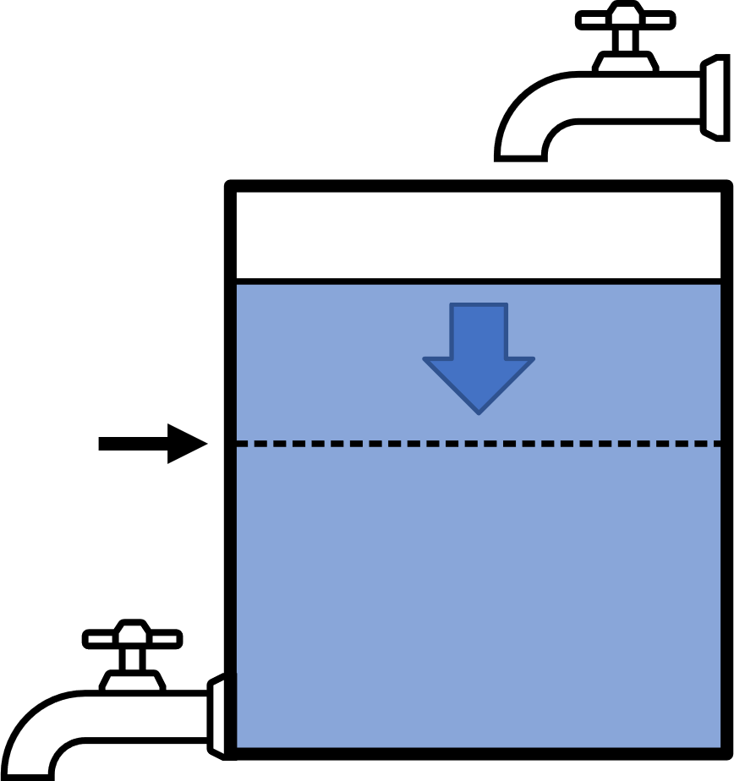
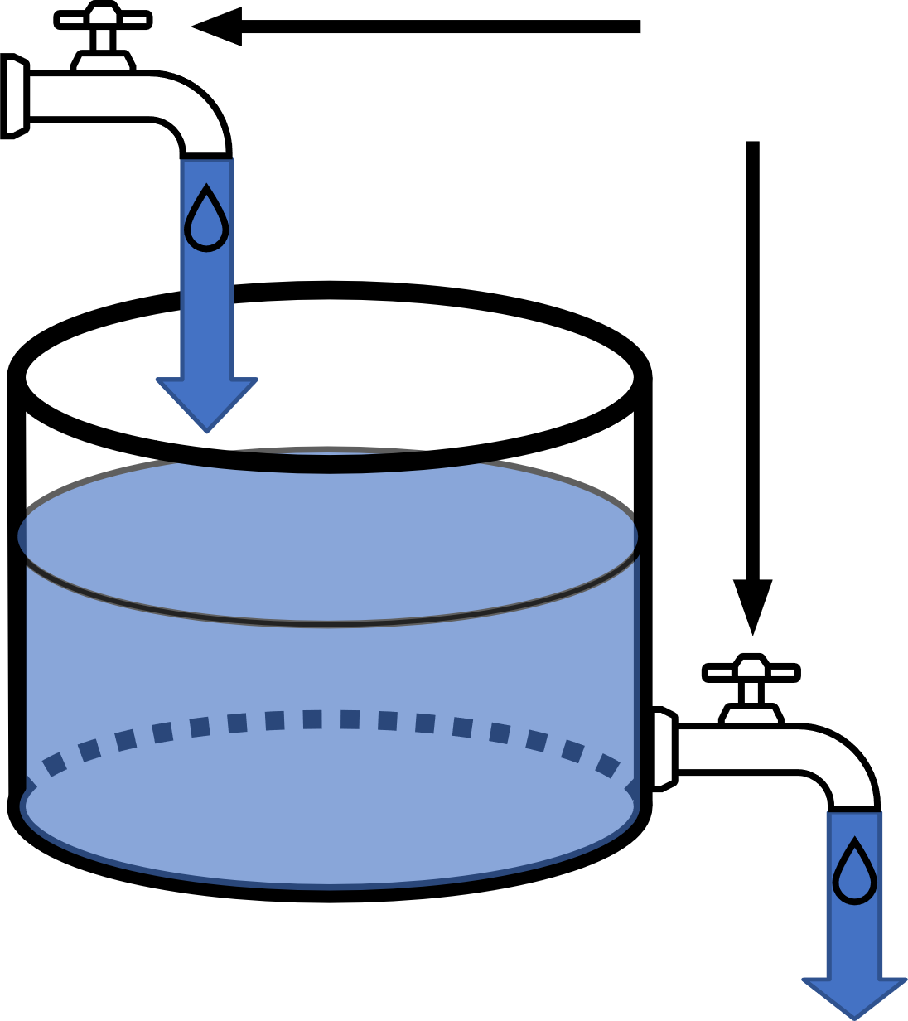
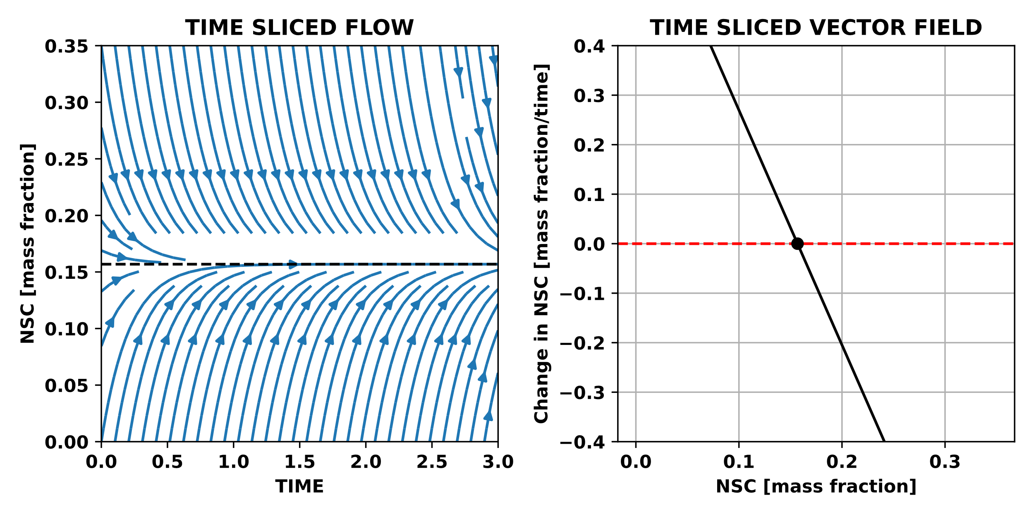
Photosynthesis
Adjustable
Balance point
NSC
Respiration + Growth
Balance point

Slide 5
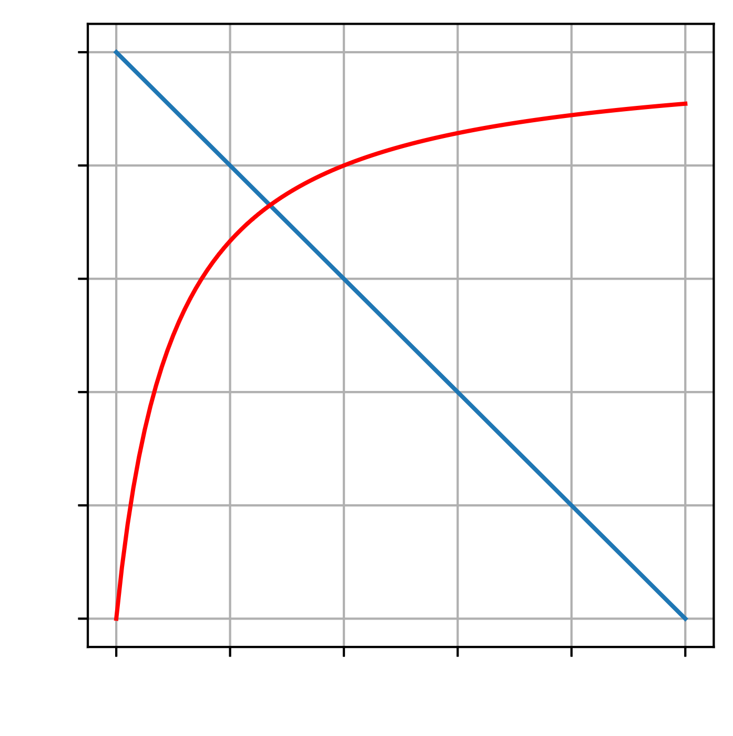
Photosynthesis = Supply
Demand Rate
Adjustable
Rate
Supply Rate
Respiration + Growth = Demand
NSC

Slide 6
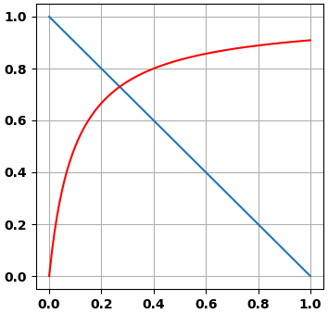
Photosynthesis = Supply
Adjustable
Rate
NSC
Respiration + Growth = Demand

Slide 7
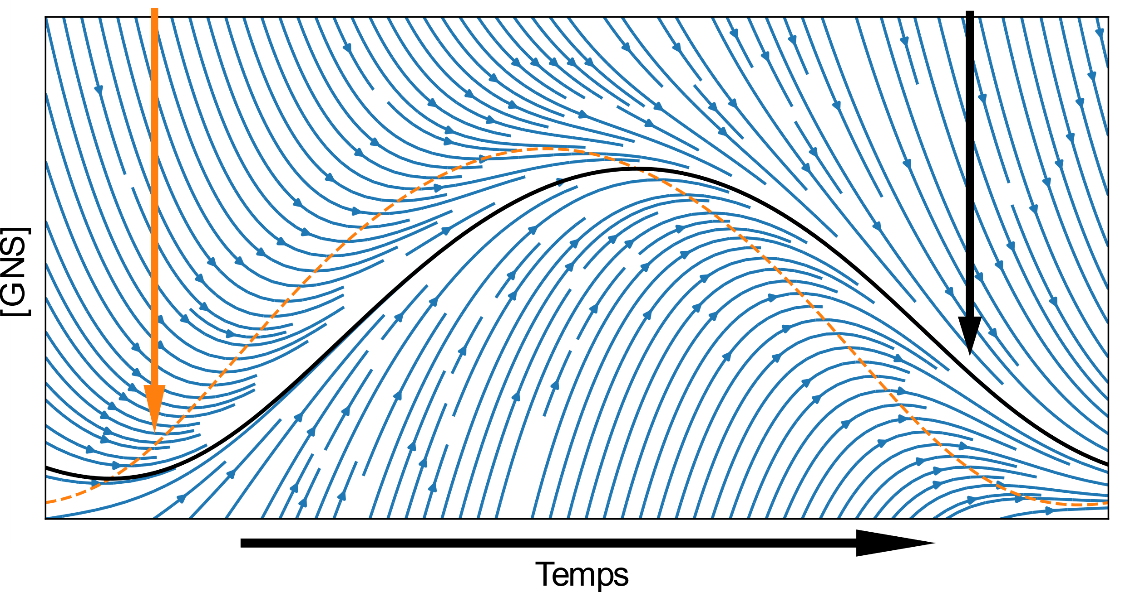
Balance point
Attractor
[NSC]
Time

Slide 8
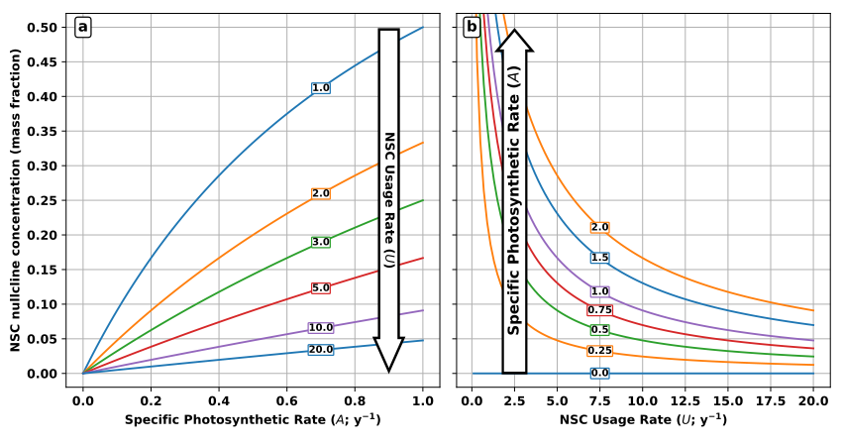
NSC balance point (mass fraction)

Slide 9
NSC balance point (mass fraction)

Slide 10
Supply driven
Demand driven

Slide 11
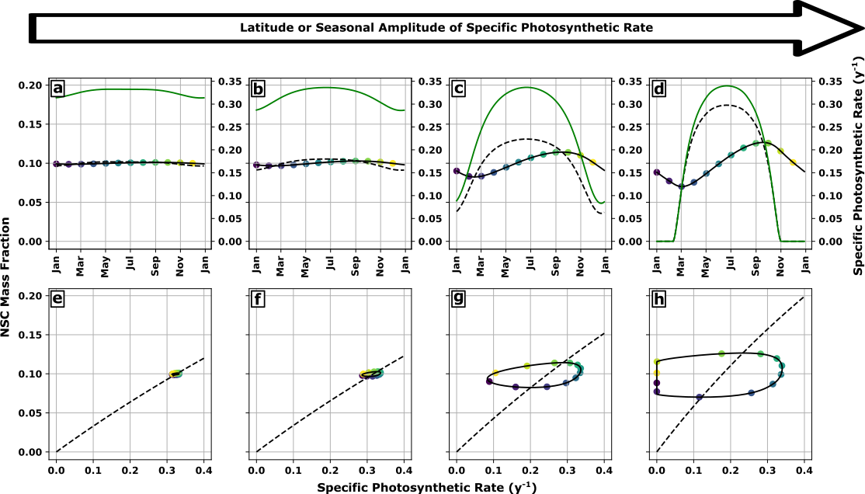

Slide 13
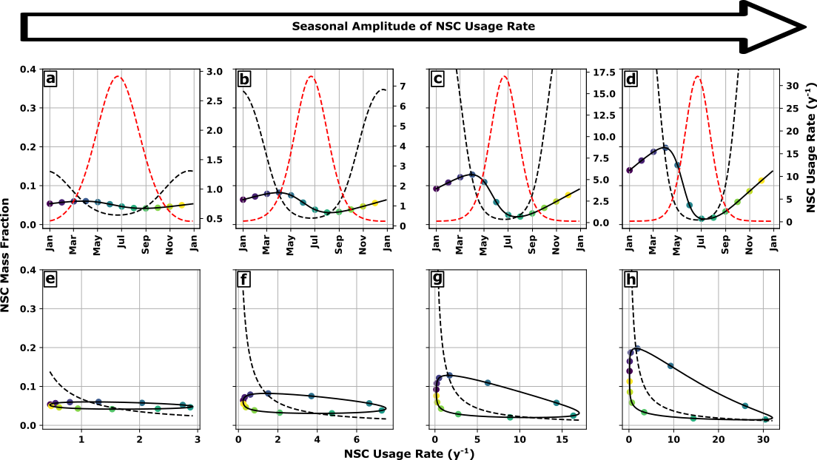

Slide 14
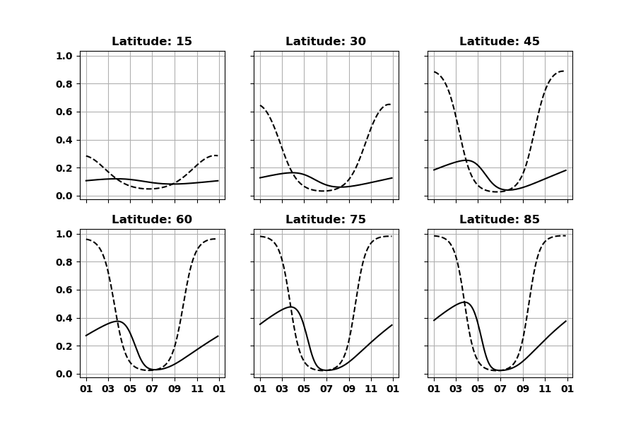

Slide 15
Balance point
Attractor
[NSC]
Time

Slide 16
Photosynthesis = Supply
Demand Rate
Adjustable
Rate
Supply Rate
Respiration + Growth = Demand
NSC

Slide 17
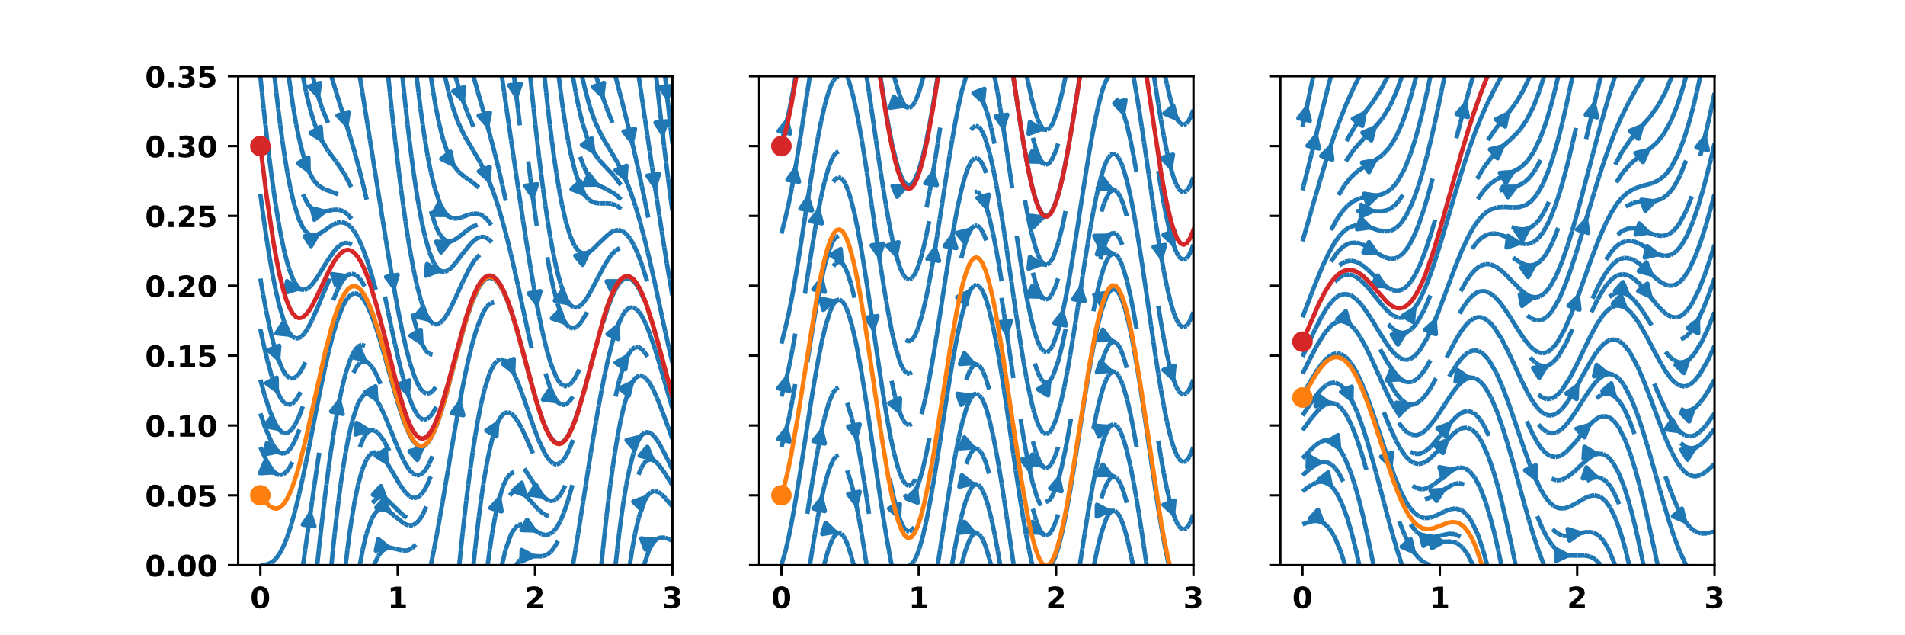
Stable
NSC (mass fraction)
Time (y)

Slide 18
Stable
Non Stable
NSC (mass fraction)
Time (y)
Time (y)

Slide 19
Stable
Non Stable
Unstable
NSC (mass fraction)
Time (y)

Slide 20
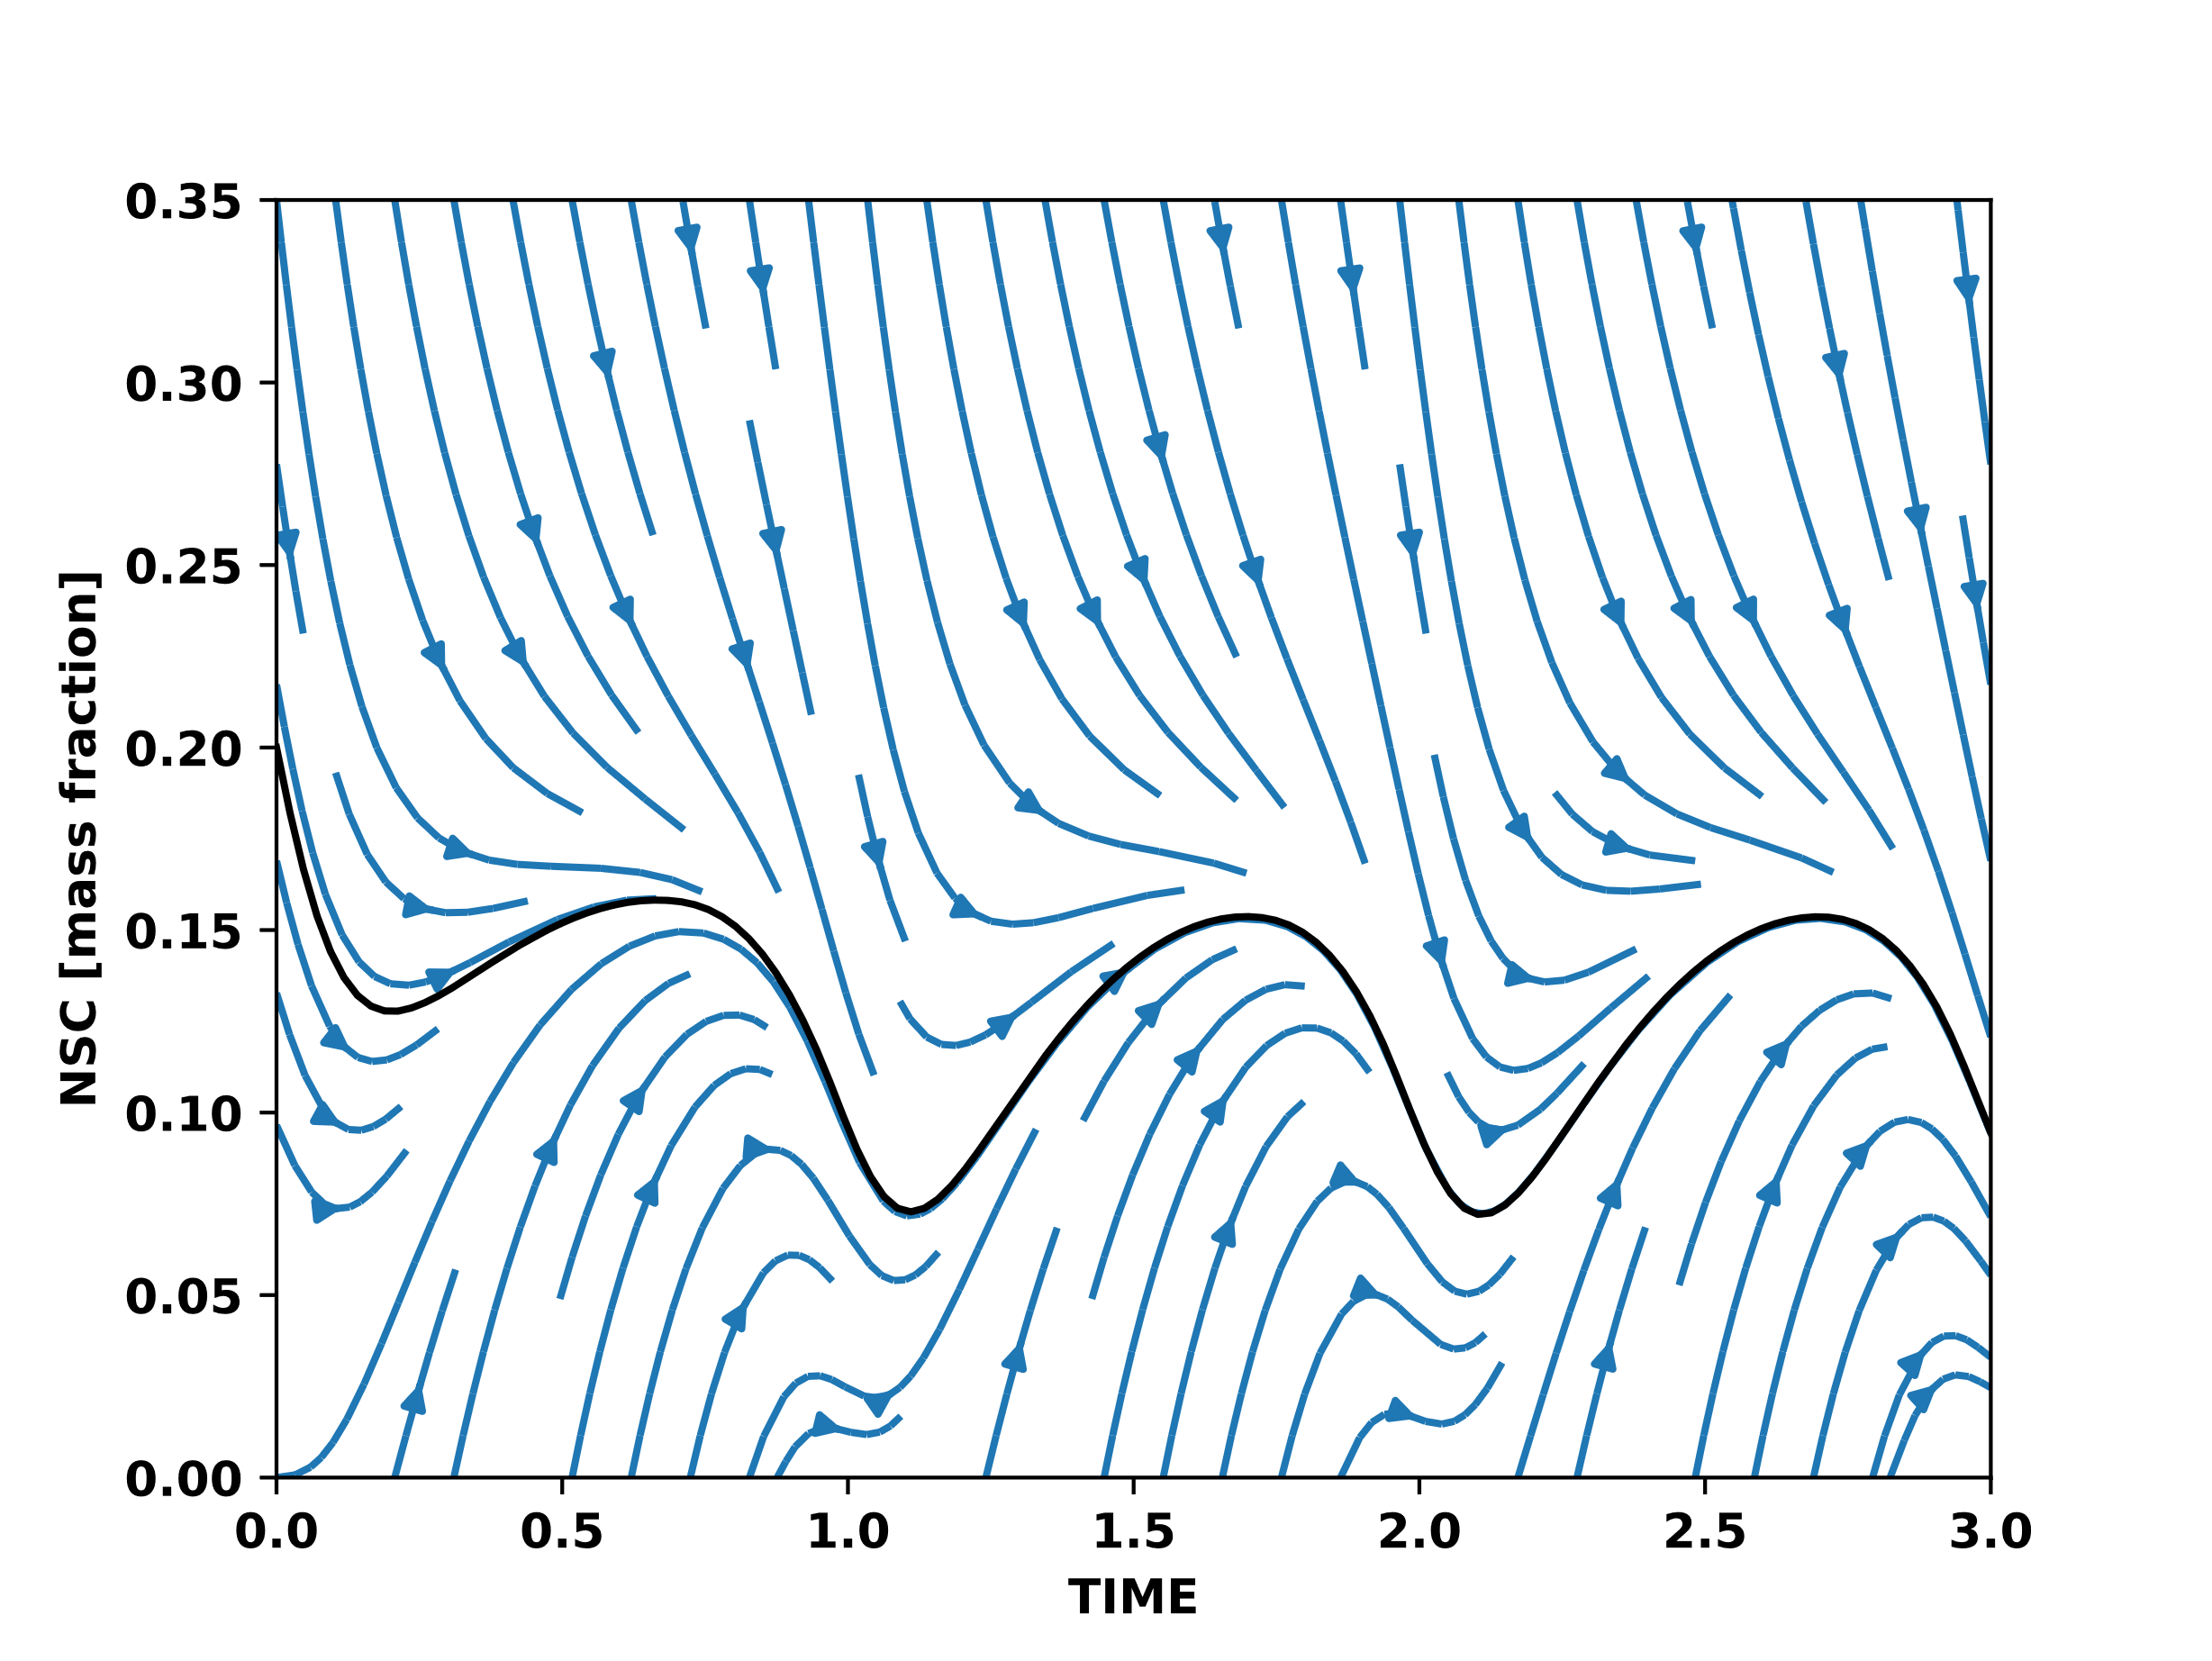
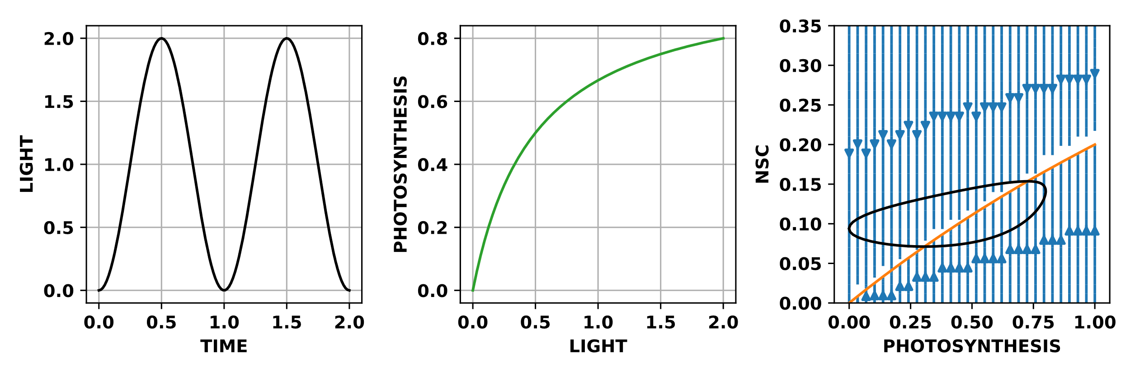
Stable for all environments

Slide 21
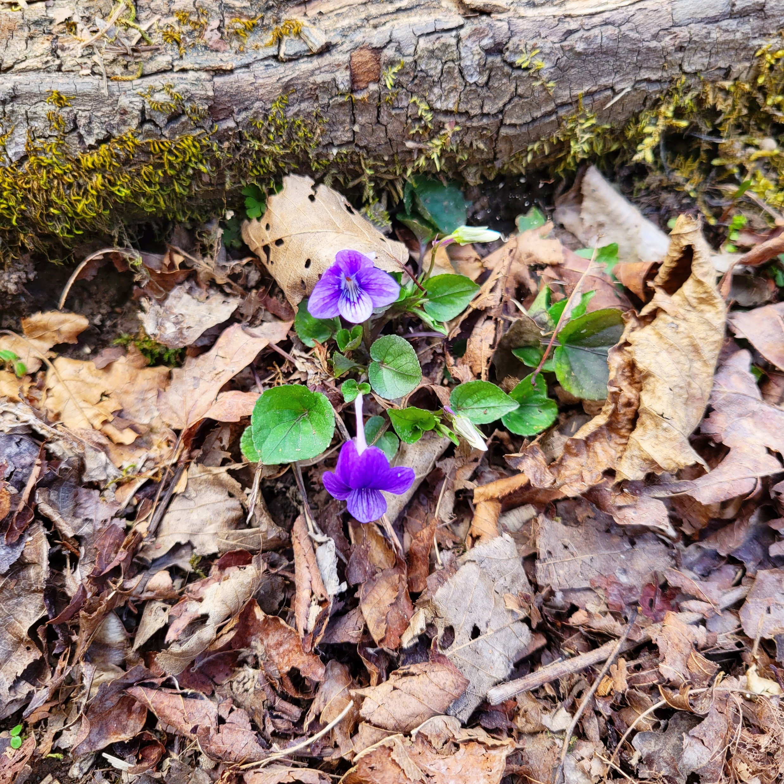
Summary
Stability → Attractor
Attractor → NSC feedback
Complex environment
→ Complex attractor

Slide 22
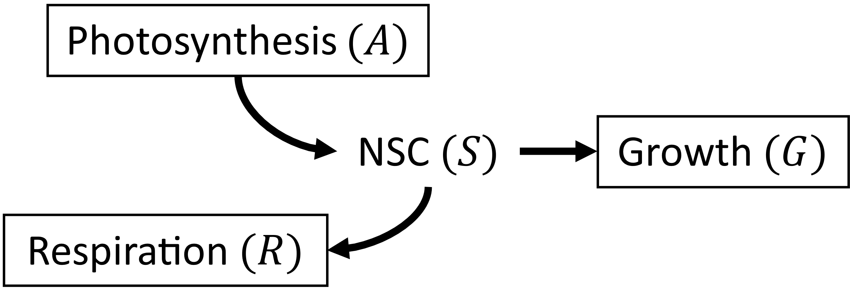
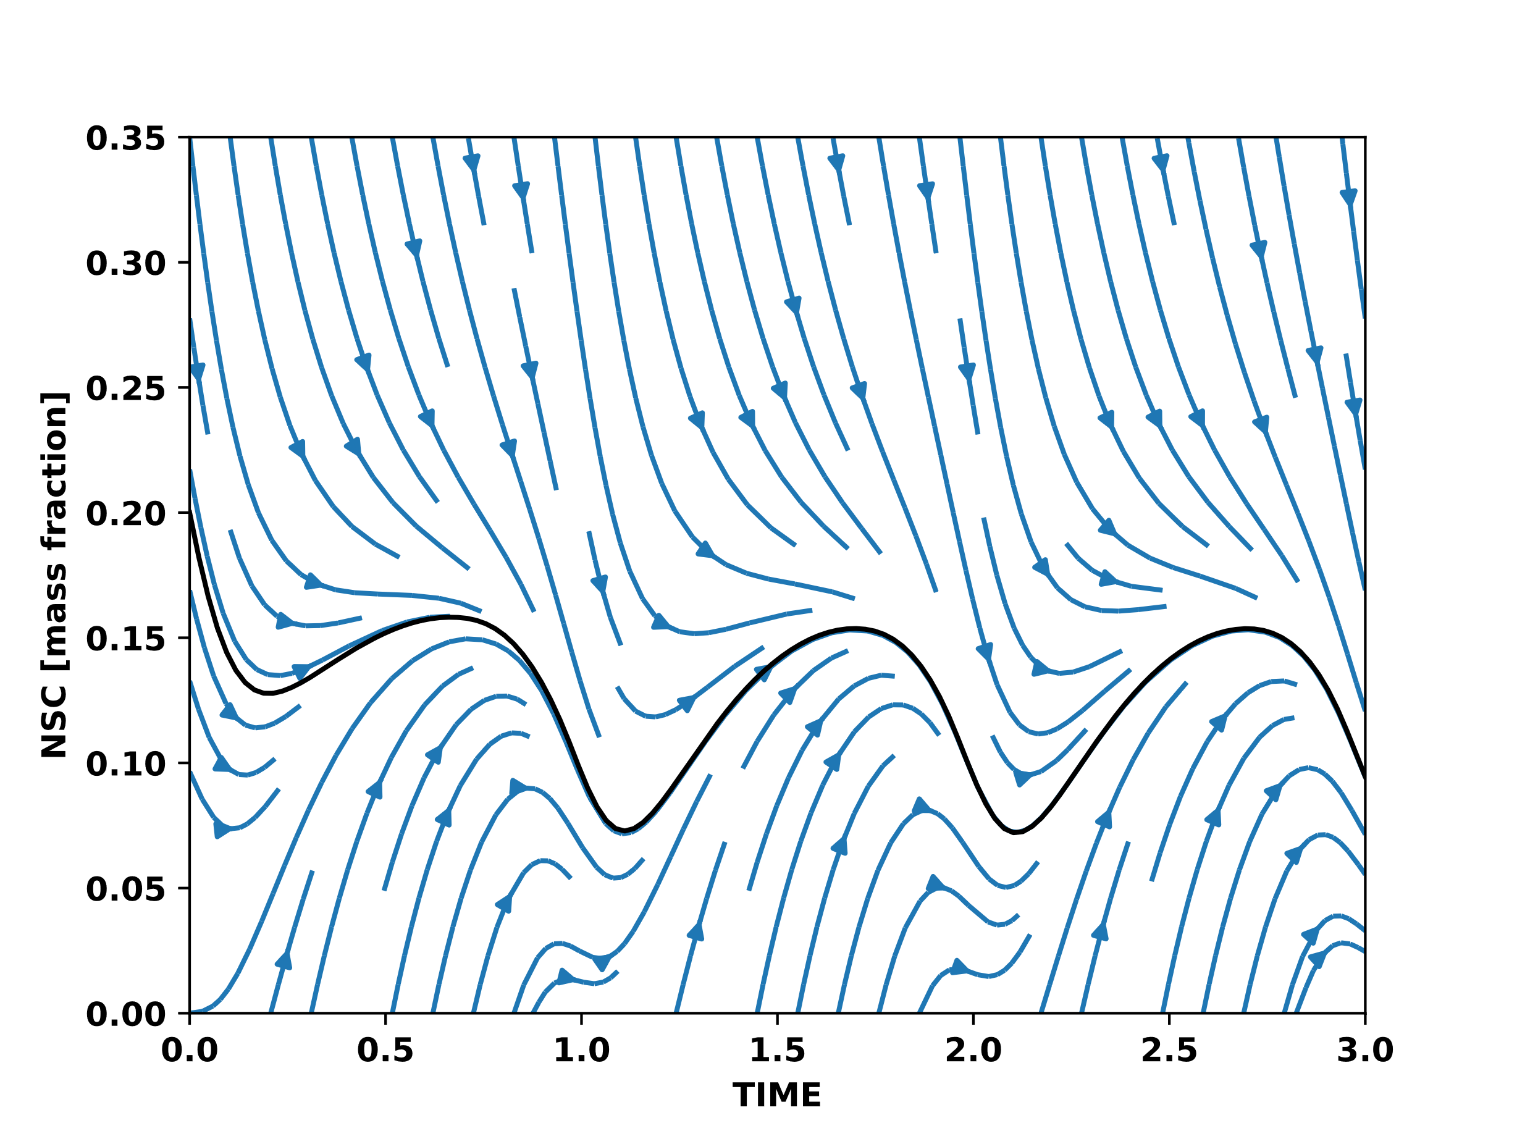
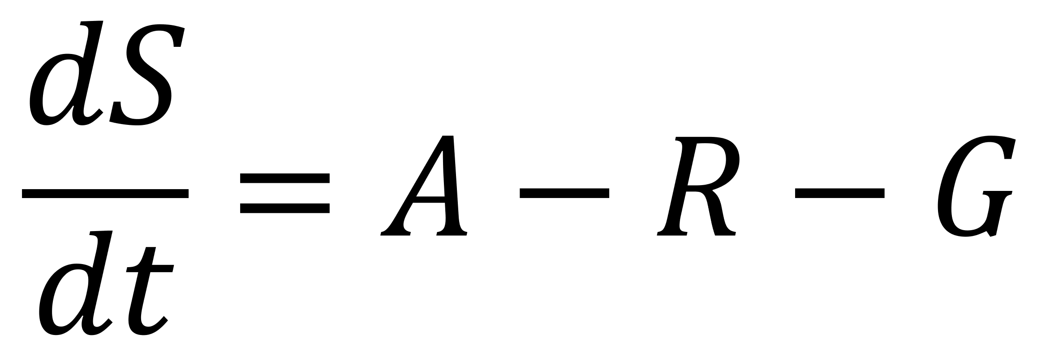
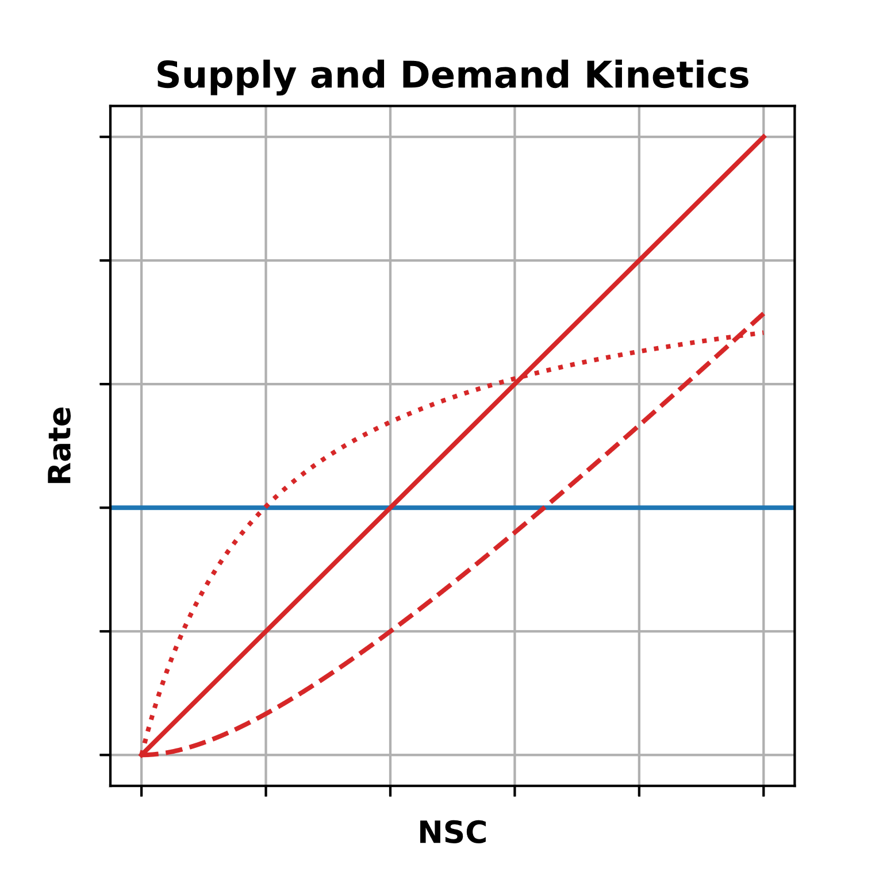

Slide 24
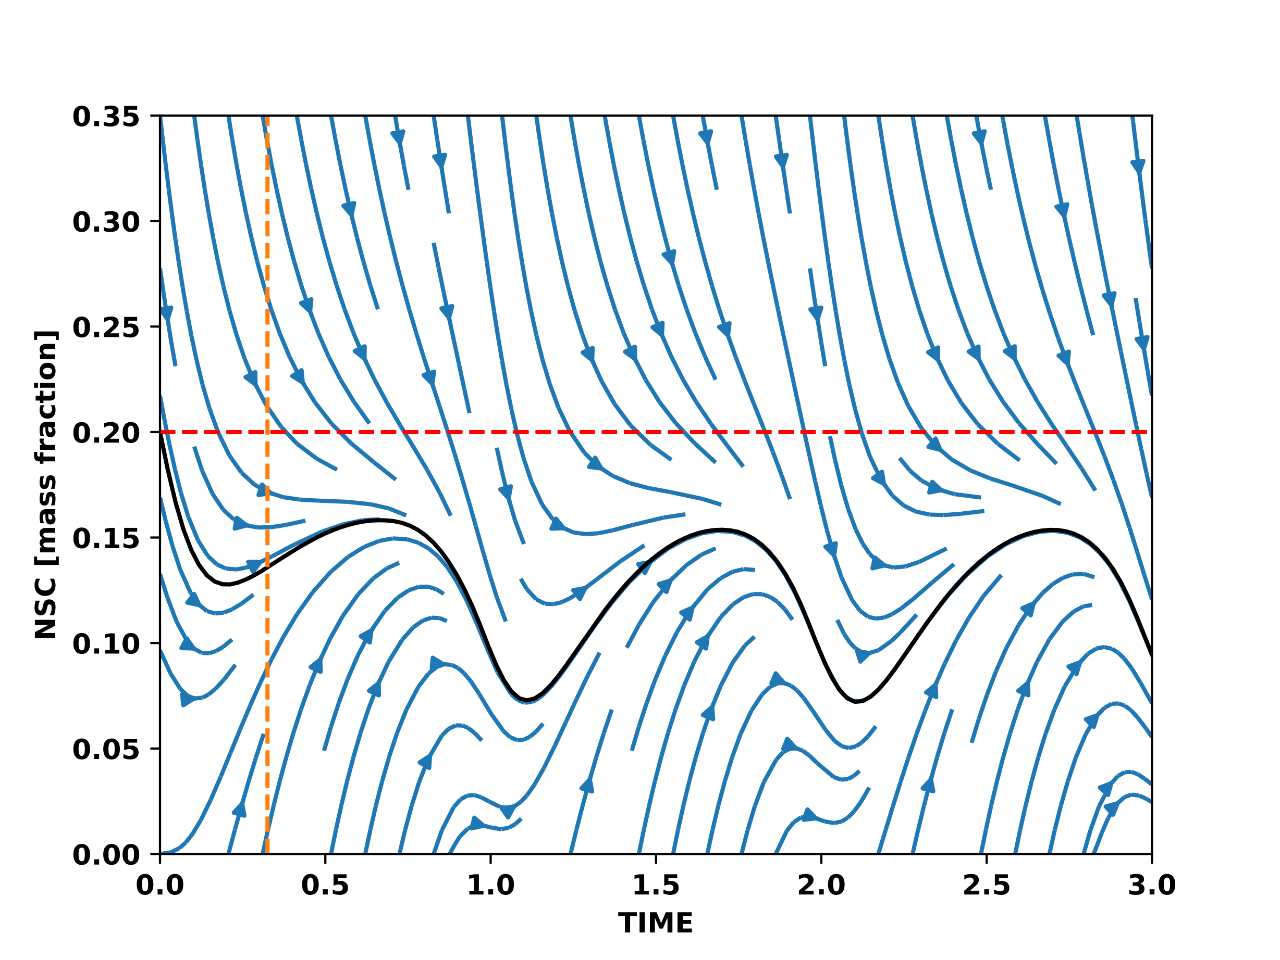
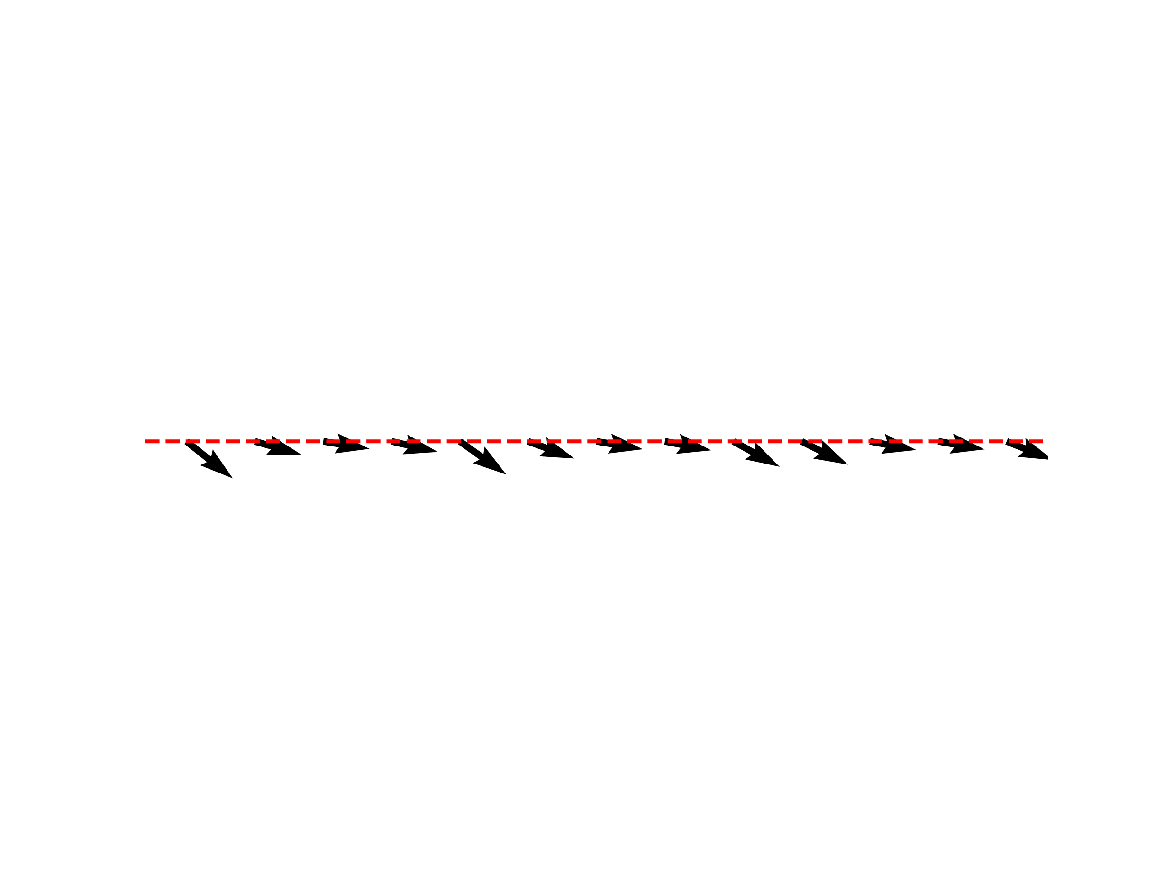
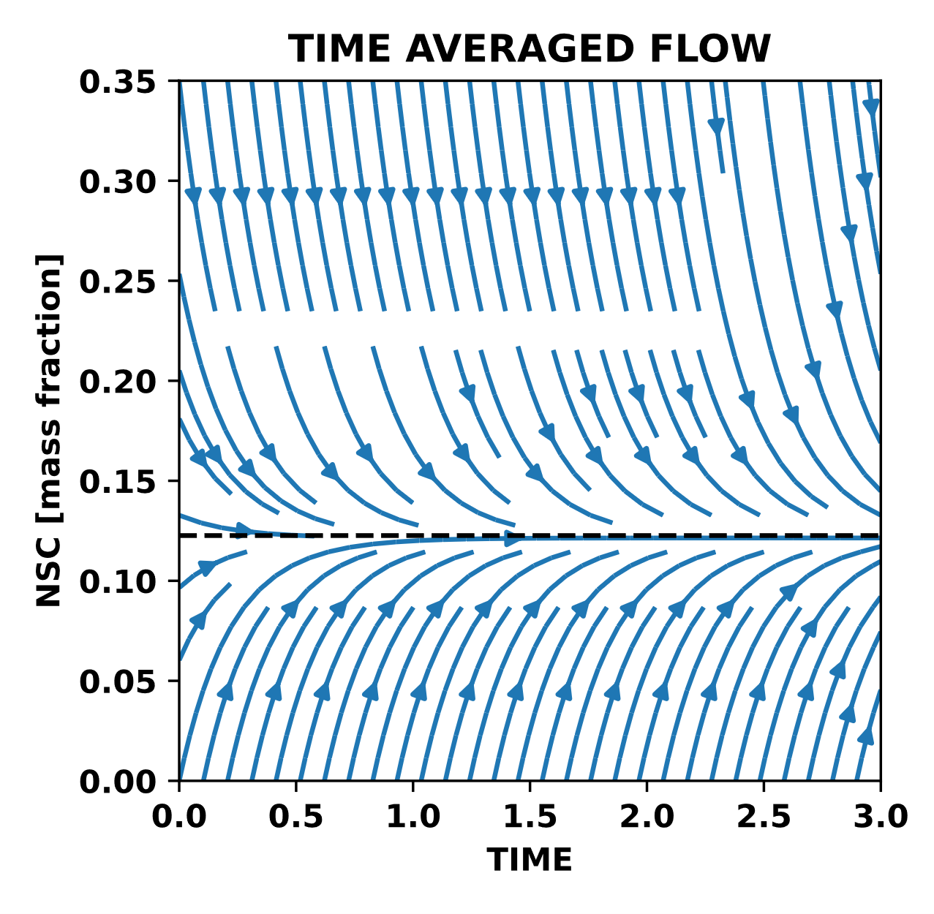

Slide 25
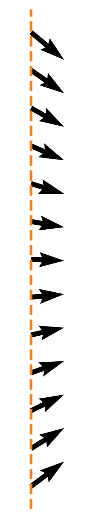

Slide 26
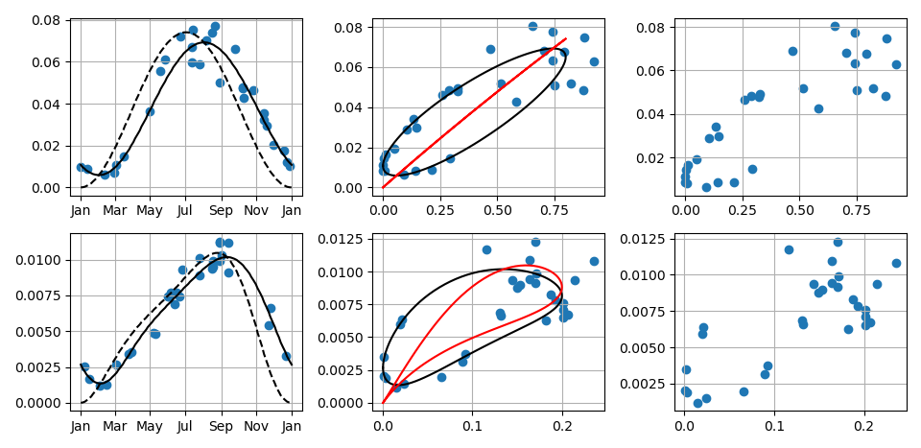

Slide 27
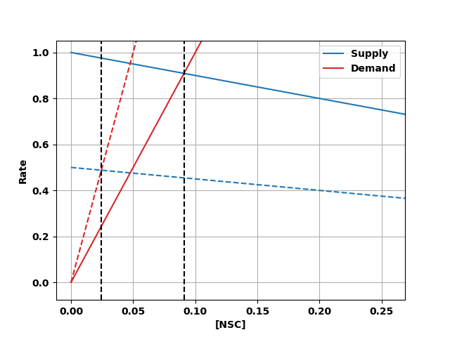
Photosynthesis = Supply
Adjustable
Respiration + Growth = Demand

